Slide 1

FACIAL EXPRESSION RECOGNITION PROJECT

Slide 2

Highlights
1-
Problem Definition
4-
2-
3
Face
Detection
Steps
- libraries
Facial expression
recognition
8-
Future work
5-
6-
7-
Dataset
Model & Training

Slide 3
PROBLEM DEFINITION
The objective of this project is to develop a robust facial expression recognition system using Convolutional Neural Networks (CNNs). Facial expression recognition plays a vital role in various applications, including human-computer interaction, emotion analysis, and affective computing. The goal is to accurately classify facial expressions into predefined emotion categories such as happiness, sadness, anger, surprise, disgust, fear, and neutral.

Slide 4

STEPS
Photo
Face detection
model
Selected Faces
Faces position
Selected Faces
Facial expression category
angry, disgust, scared, happy, sad, surprised, neutral
Facial expression recognition model

Slide 5
LIBRARIES
Pillow and OpenCv:-
Used for opening, manipulating, and saving images.
Used for face detection and capturing images from the camera.
The face detection algorithm is implemented using the Haar Cascade Classifier
In general --> for image processing.

Slide 6
LIBRARIES
NumPy:
NumPy is a powerful library for numerical operations in Python, particularly for working with arrays.
In the code, NumPy is used to manipulate image data. For example:
onp.expand_dims: Adds an extra dimension to the image data array.
oimg_pixels /= 255.0: Normalizes the pixel values to be in the range [0, 1].

Slide 7
LIBRARIES
TensorFlow / Keras:
TensorFlow is a deep learning framework, and in this code, Keras (which is integrated into TensorFlow) is used for loading and using a pre-trained neural network model.
Keras functions like img_to_array, model_from_json, and load_weights are used for image preprocessing and loading a pre-trained model.

Slide 8
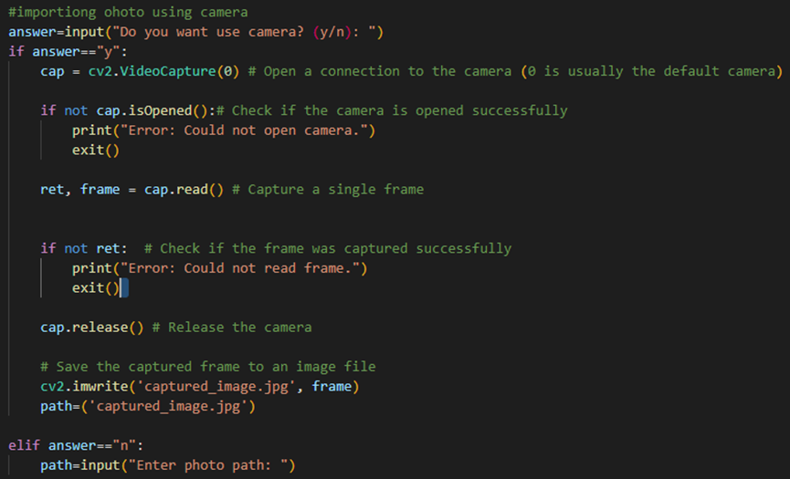
FACE DETECTION
Code Time:
The user is prompted to enter either "y" or "n" to decide whether to use the camera or provide a photo path.
Description:
If the user chooses to use the camera, it opens a connection to the default camera, captures a single frame, saves it as "captured_image.jpg," and sets the path variable to the image file path.
If the user chooses not to use the camera, they are prompted to enter the path to an existing photo.

Slide 9
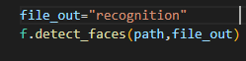
FACE DETECTION
Code Time:
detect_faces function from a module named f to perform face detection on the specified image (path) and saves the detected faces in the "recognition" directory.

Slide 10
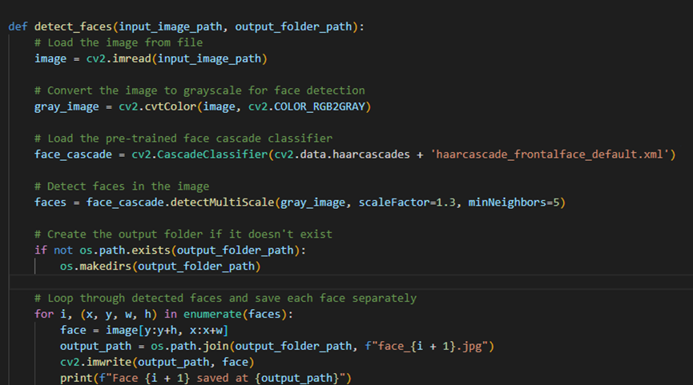
FACE DETECTION
Code Time:
This function takes an input image, detects faces using a pre-trained Haar cascade classifier, and saves each detected face as a separate image in the specified output folder.

Slide 11
FACE DETECTION
What is cascade classifier:-
Object Detection using Haar feature-based cascade classifiers is an effective object detection method proposed by Paul Viola and Michael Jones in their paper, "Rapid Object Detection using a Boosted Cascade of Simple Features" in 2001. It is a machine learning based approach where a cascade function is trained from a lot of positive and negative images. It is then used to detect objects in other images.
Here we will work with face detection. Initially, the algorithm needs a lot of positive images (images of faces) and negative images (images without faces) to train the classifier. Then we need to extract features from it. For this, Haar features shown in the below image are used. They are just like our convolutional kernel. Each feature is a single value obtained by subtracting sum of pixels under the white rectangle from sum of pixels under the black rectangle.

Slide 12
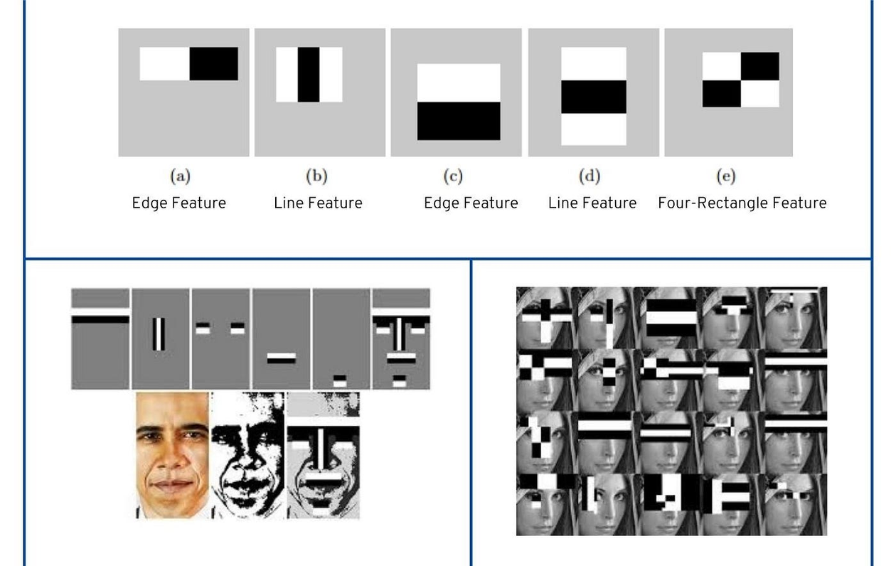
FACE DETECTION
Cascade classifier in face detiction:-

Slide 13
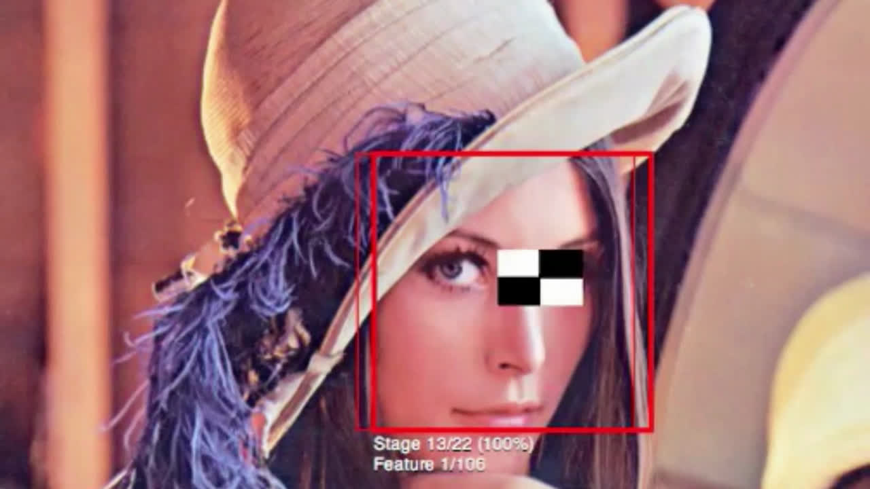
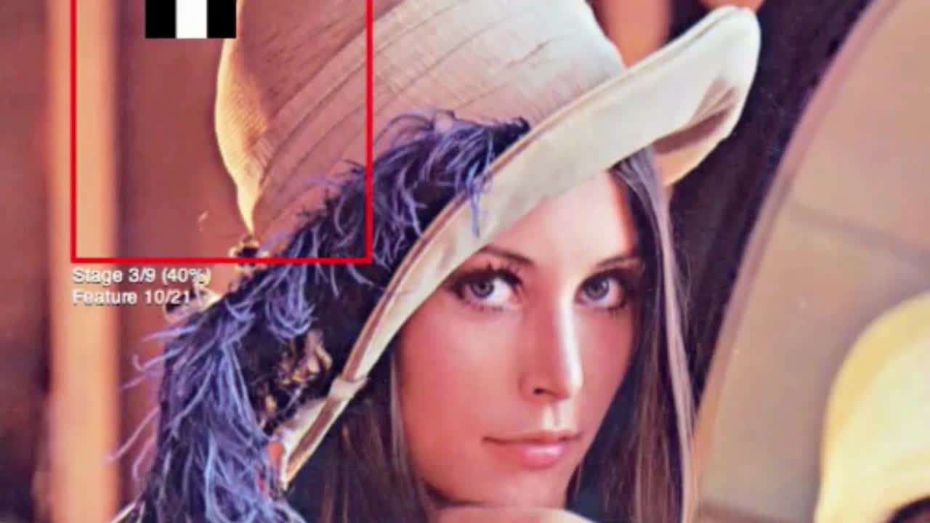
FACE DETECTION
Cascade classifier in face detiction:-
Example
Face
Non Face

Slide 14
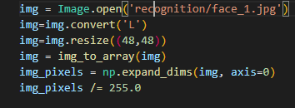
FACIAL EXPRESSION RECOGNITION
Code:
It opens an image file using the PIL `Image.open` function.

Slide 15
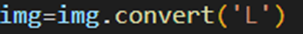
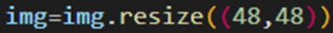
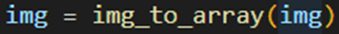
FACIAL EXPRESSION RECOGNITION
Code:
It converts the opened image to grayscale using the `convert` method with the argument `'L'`, which stands for luminance.
It resizes the image to a specified size of (48, 48) pixels using the `resize` method.
It converts the PIL image to a NumPy array using the `img_to_array` function from Keras utilities. This function is useful when working with deep learning models that accept NumPy arrays as input.

Slide 16
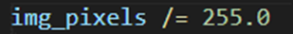
FACIAL EXPRESSION RECOGNITION
Code:
It adds an extra dimension to the array using `np.expand_dims`. This is often necessary when working with deep learning models that expect input data to have a certain shape, typically with a batch dimension.
It normalizes the pixel values to be in the range [0, 1]. This is a common preprocessing step in deep learning to ensure that the input data is within a standard range.

Slide 17
FACIAL EXPRESSION RECOGNITION
Code:
This code reads the model architecture from a JSON file (modelcomplete.json) and stores it in the loaded_model_json variable.
Using model_from_json, the model architecture is reconstructed from the JSON file. Then, the weights are loaded from an HDF5 file (modelcomplete.h5) using load_weights.

Slide 18
FACIAL EXPRESSION RECOGNITION
Code:
Make a prediction

Slide 19
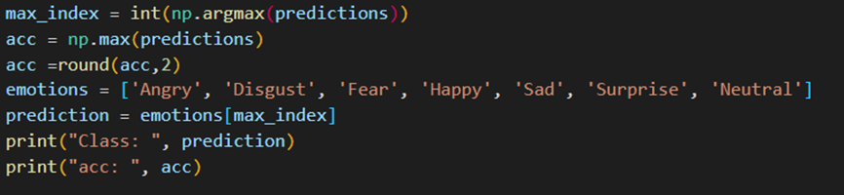
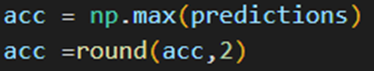
FACIAL EXPRESSION RECOGNITION
Code:
returns the index of the maximum value in the array and converted it to an int number
maximum probability value from the array predictions and round it to two decimal places.

Slide 20
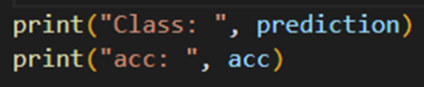
FACIAL EXPRESSION RECOGNITION
Code:
retrieving the human-readable label of the predicted class.
Outputs the predicted class label to the console and the rounded accuracy (probability).
Open and display the image file 'face_1.jpg' located in the 'recognition' directory using the PIL Image.open function.

Slide 21

DATASET
The Fer2013 dataset is made up of about 30,000 black-and-white facial images, each sized at 48×48 pixels. These images show different expressions, falling into seven categories: Angry (0), Disgust (1), Fear (2), Happy (3), Sad (4), Surprise (5), and Neutral (6). The Disgust category has the least images, around 600, while the others have almost 5,000 each, making it a well-rounded dataset for studying facial expressions.

Slide 22
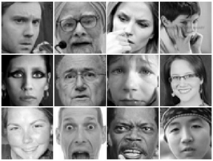
DATASET
Dataset Examples

Slide 23

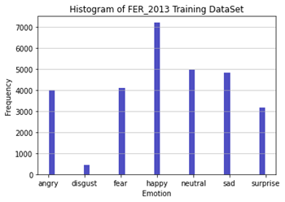
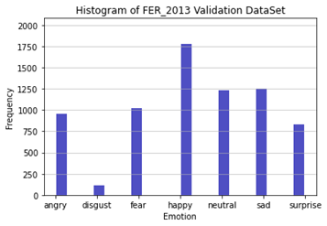
DATASET DISTRIBUTION
Validation Distribution
Training Distribution

Slide 24
DATASET PROS AND CONS
Pros:
Large and Diverse: The FER2013 dataset is one of the largest and most diverse FER datasets available. It includes images of people from a variety of ethnicities, ages, and genders, and it covers a wide range of facial expressions.
High-Quality Images: The images in the FER2013 dataset are of high quality and are well-aligned. This makes it easier for machine learning models to learn from the data.
Well-Labeled: The images in the FER2013 dataset are well-labeled, which means that the emotion for each image is accurately and consistently labeled. This makes it easier for researchers to evaluate the performance of their models.

Slide 25
DATASET PROS AND CONS
Cons:
Limited Emotion Coverage: The FER2013 dataset only includes seven basic emotions, which may not be sufficient for some applications. For example, the dataset does not include emotions such as boredom or contempt.
Subjectivity of Emotion Recognition: Facial expression recognition is a subjective task, as different people may interpret the same facial expression differently. This means that the performance of models trained on the FER2013 dataset may not always generalize well to real-world scenarios.
Data Imbalance: The FER2013 dataset is slightly imbalanced, with more images of some emotions (e.g., neutral) than others. This can make it more difficult for models to learn to recognize the less common emotions.
Eyeglasses : there is no one have eyeglasses in this dataset.

Slide 26
MODEL & TRAINING

Slide 27
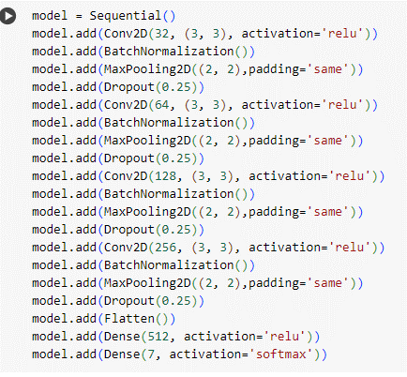

MODEL ARCHITECTURE
Hyper parameters
Img_size=(48,48)
Batchsize=64
Num_epochs=150
Input_shape=(48,48,1)
Patience=5

Slide 28

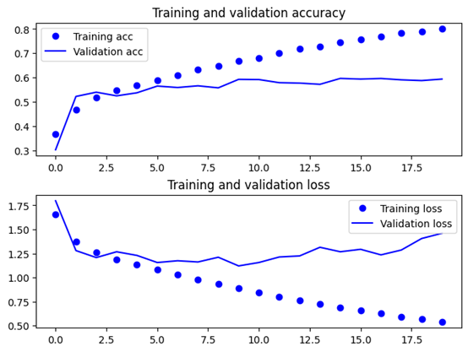
ACCURACY & LOSS Curves

Slide 29



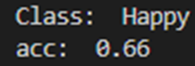
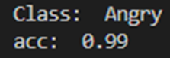
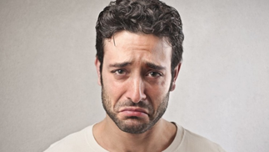
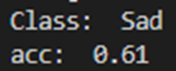
RESULTS

Slide 30
FUTURE WORK
What's the future work??
The first step in the future work should be improving accuracy and robustness of the system:
Larger and more diverse datasets: Train on data that better reflects real-world variability in age, ethnicity, gender, and environmental conditions.
Advanced model architectures: Explore deeper neural networks, ensemble methods, or attention mechanisms to capture finer details and context in facial expressions.
Dynamic feature extraction: Develop adaptive methods that extract features based on specific emotions or contextual factors.
Data augmantation to solve imbalance problem
And not only improving accuracy, but also expanding beyond basic emotions:
Micro-expressions: Recognize subtle, fleeting expressions that can reveal hidden emotions or deception.
Complex emotional states: Differentiate between nuanced emotions like amusement, contempt, or frustration.
Cultural considerations: Adapt the model to recognize emotion expressions across different cultures.

Slide 31


TEAM MEMBERS:
Mohammed Ehab Mansour
Mohammed Sayed Ahmed Zayed
khalid ayman ramadan korish
Abdelmonagi Helal Abdelmonagi Salama
Youssef Mohammad Shoieb
Ibrahim Ismael Elsheikh

Slide 32

Thank You

